Slide 1
Impact of Oil Prices Based on the New York Times API

Slide 2
Objective
Determine relationship of the oil industry with sentiment based on news articles from the New York Times :
SpaCy Count Analysis
VADAR Sentiment Analysis
Backtesting Exxon stock data

Slide 3
Interest in Topic
Curious about global events that affect energy industry
Build investment strategy based on sentiment
Opportunity to explore Machine Learning tools
Practice using data extraction from an API

Slide 4
Hypothesis
Using Sentiment Analysis on historical data, we can create a trade strategy that uses sentiment scores to predict Exxon prices that will perform better than the actual stock prices.

Slide 5
Data Collection
New York Times Articles API
Crude oil historical prices
Exxon historical stock prices
All data extracted was from 2010 to 2020

Slide 6
Data Extraction
Article filtering
Keywords: oil, petroleum, energy, natural gas
Obtained article abstracts, URLs, snippets, and IDs
Saved article information in JSON format
Used Beautiful Soup to web scrape through URLs

Slide 7
Spacy Modeling
spaCy is a natural language processing model
We used this to capture all the words in the abstracts of the articles extracted
Tokenization - we tokenized the words which breaks each sentence down and separates all individual word
Lemmatization - we then used the lemmatization process to break each token down to its root word
Now our Corpas was created for each abstract and we then looped over it to count the most frequent words within the abstract
From there we searched for 7 key words: United and China, Exxon and Shell, Gas and Energy, and lastly President (removed all articles that were not related to the US president.)

Slide 8
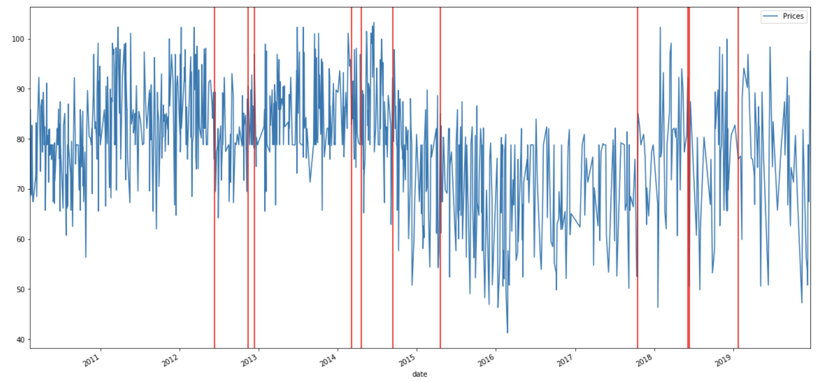
Word: United (United States)

Slide 9
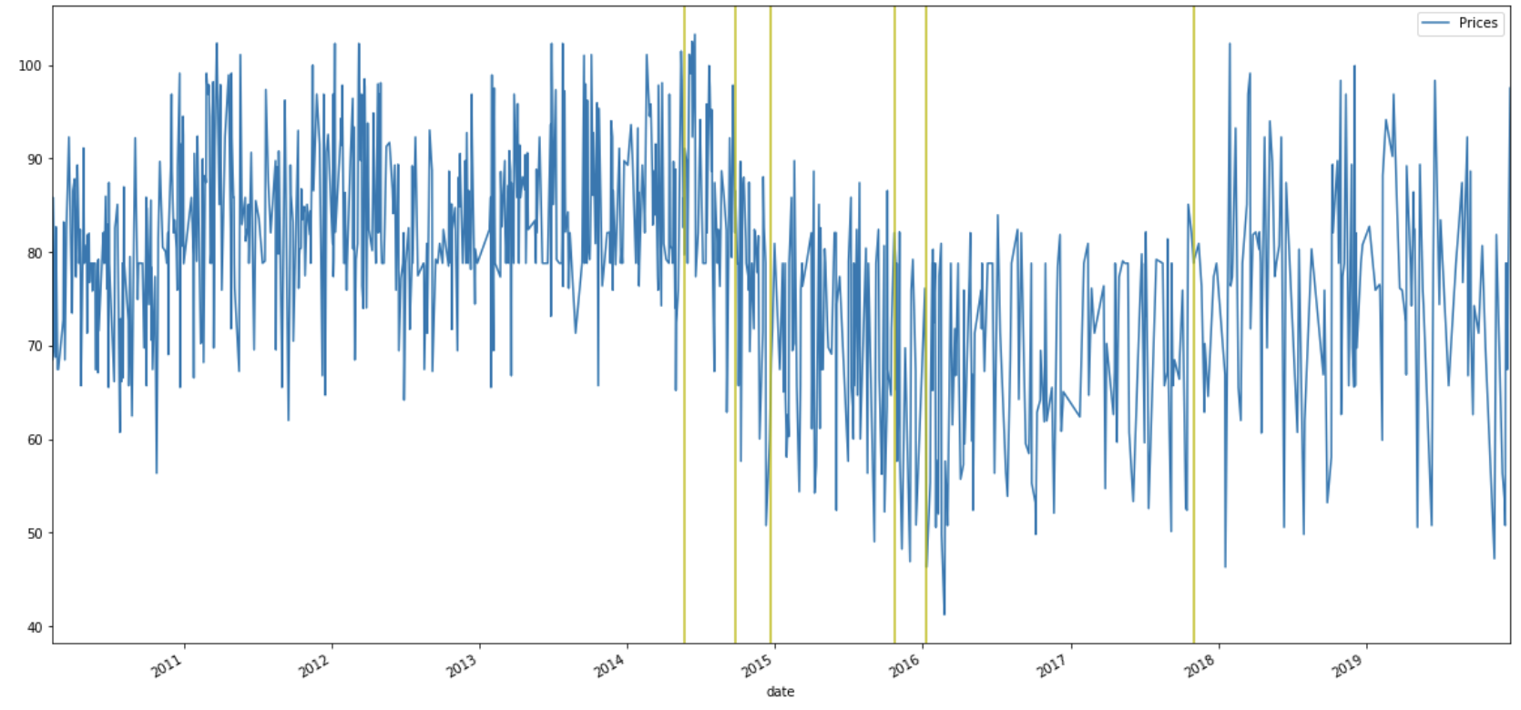
Word: China

Slide 10
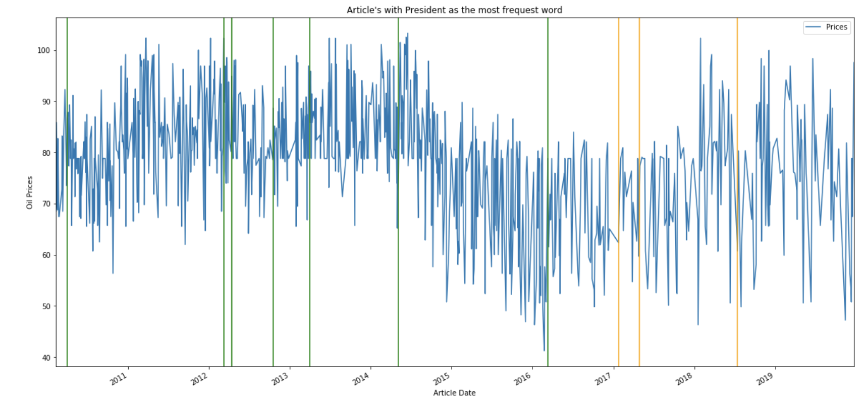
Word: President (Obama-Green, Trump=Orange)

Slide 11
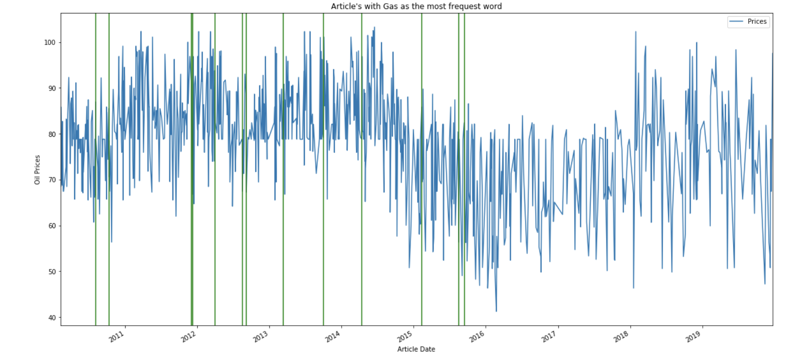
Word: Gas

Slide 12
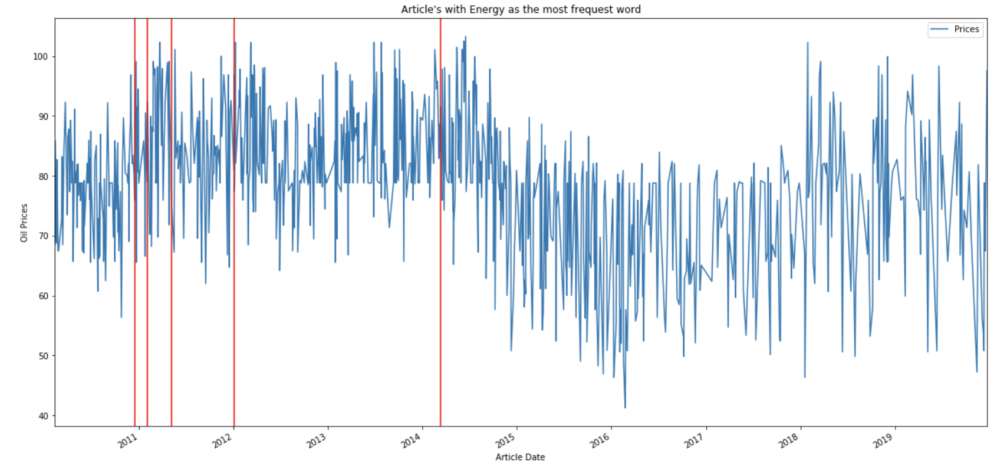
Word: Energy

Slide 13
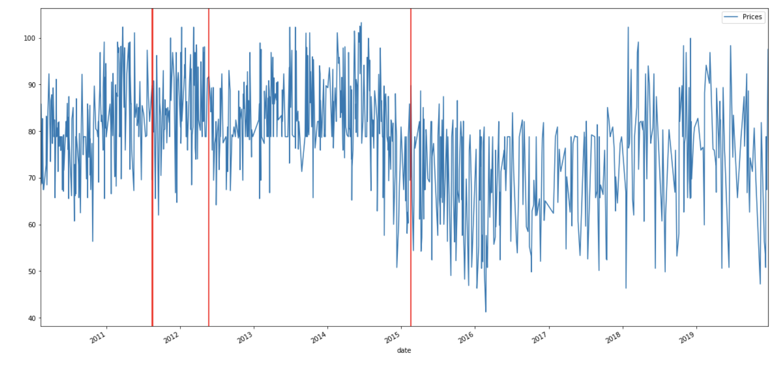
Word: Shell

Slide 14
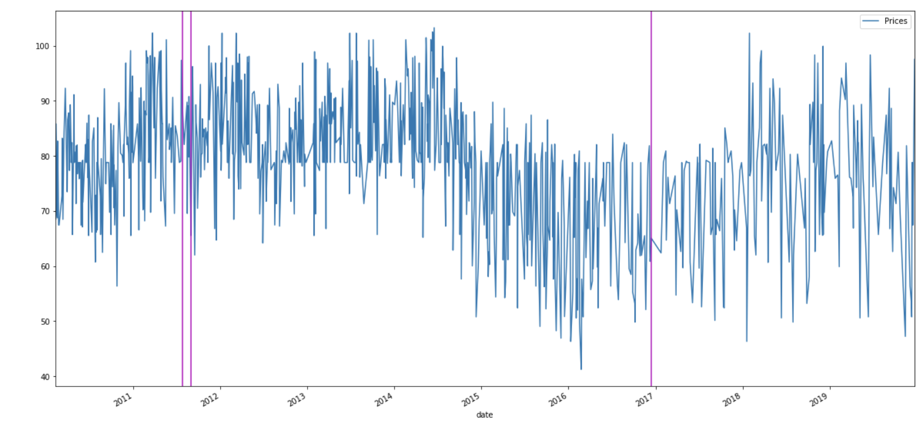
Word: Exxon

Slide 15
spaCy conclusion
We did not find much useful data from this
It does not show that the information is predictable
This could be because we only used the spaCy model on the abstracts and not the entire articles

Slide 16
VADER Sentiment Analysis
NLTK – Natural Language Tookit
Loop through JSON data of article snippets
VADER opinion mining
Range of compound score from -1 to 1
Positive: >= 0.5
Neutral: >= -0.5 and < 0.5
Negative: <= -0.5

Slide 17

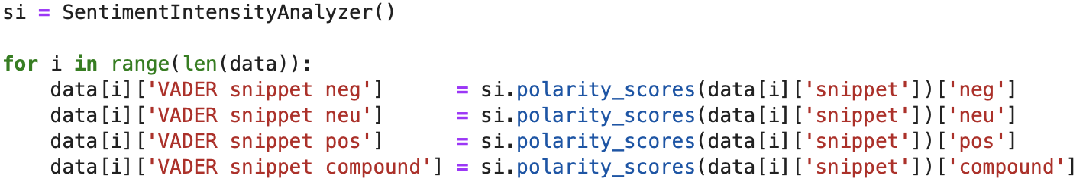
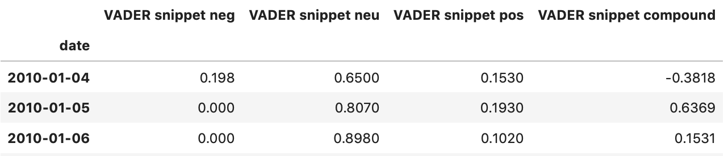
VADER Code

Slide 18

Random Forest Regression with Crude Oil Prices
Combines the predictions of training data to produce decision trees
Averages the predictions from all trees
https://towardsdatascience.com/random-forest-and-its-implementation-71824ced454f

Slide 19
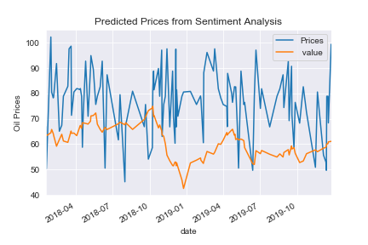
Predicted Oil Prices vs Actual

Slide 20
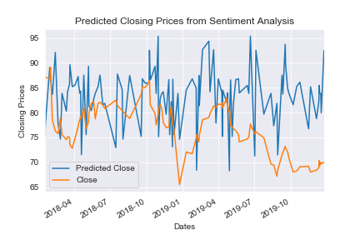
Random Tree Regression with Exxon Stock Data

Slide 21
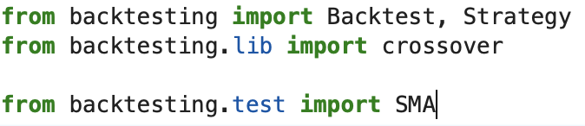
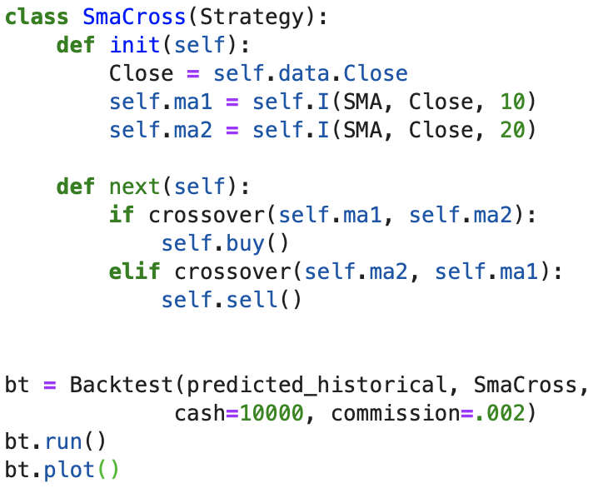
Backtesting Exxon Stock Data

Slide 22
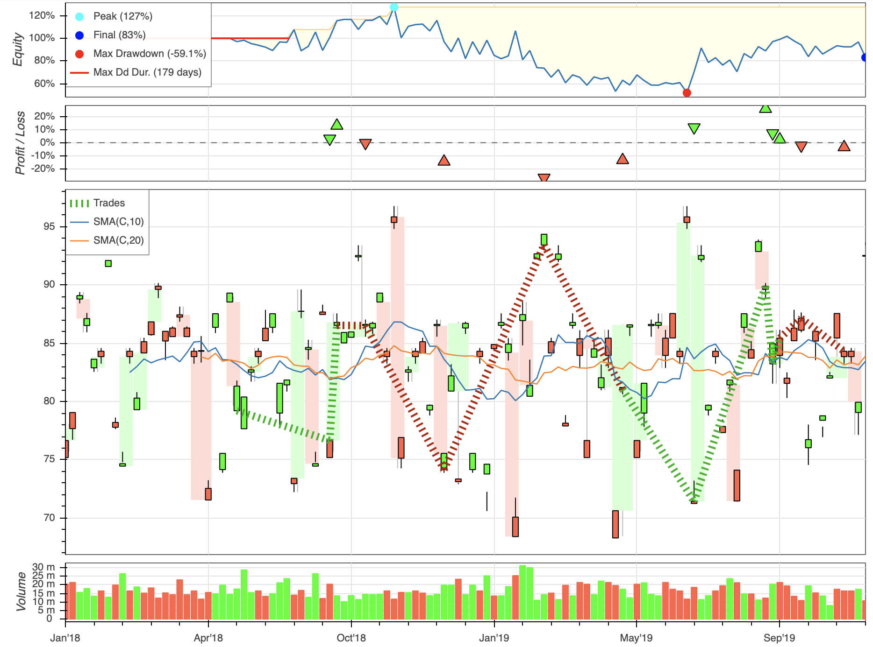
Investing Strategy for Exxon for the Previous Two Years

Slide 23
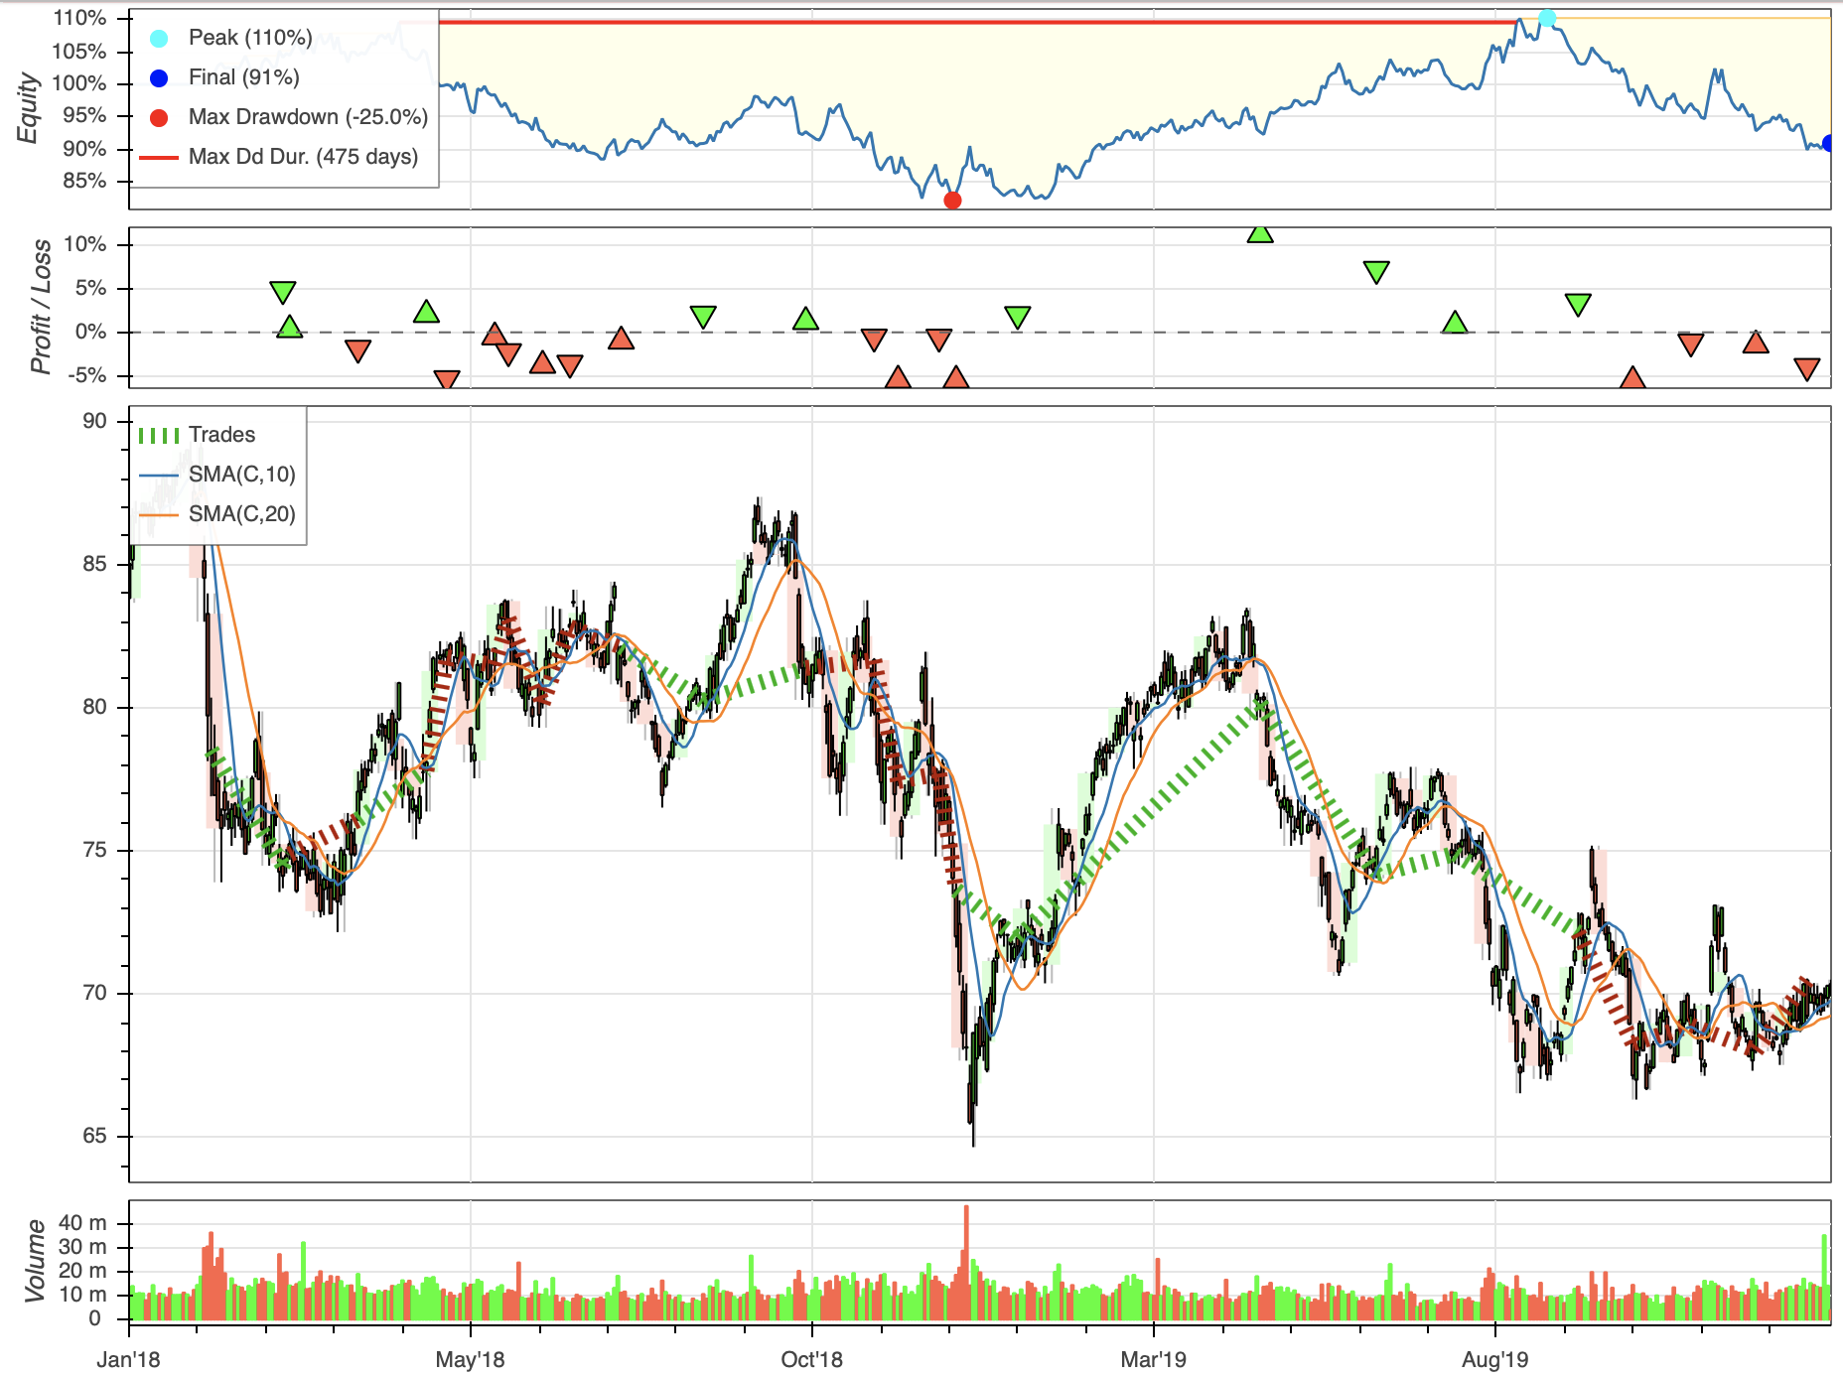
Predicted Prices for the Last 2 Years
Actual Prices for Last 2 Years

Slide 24
Backtesting Conclusion
Using Sentiment Analysis to predict Exxon stock prices for the past two years did not overperform the actual stock prices from the previous two years.

